Slide 1

w.6. SEA dan SEM

Slide 2
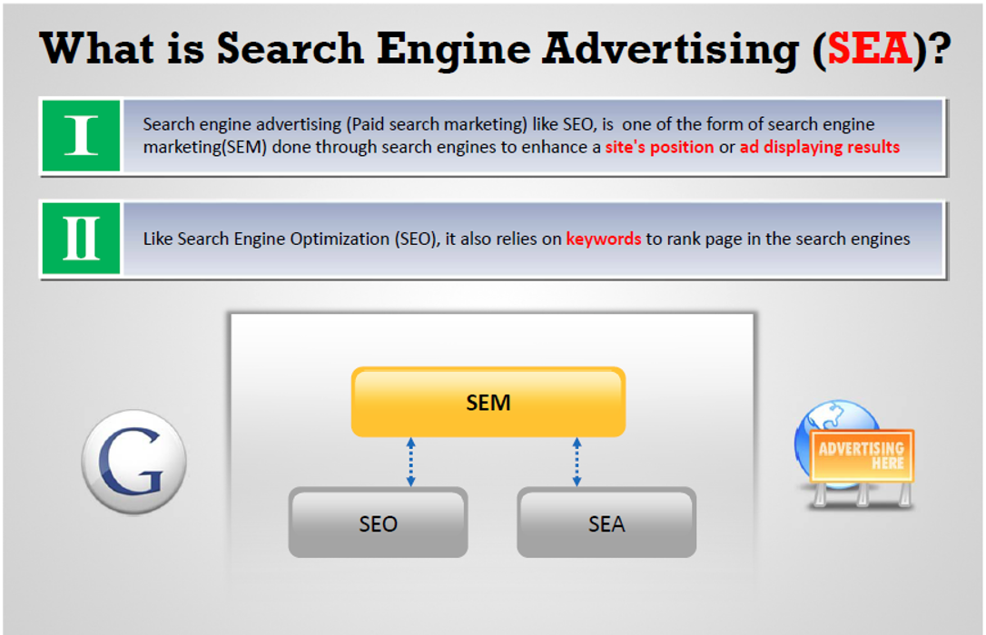

Slide 3
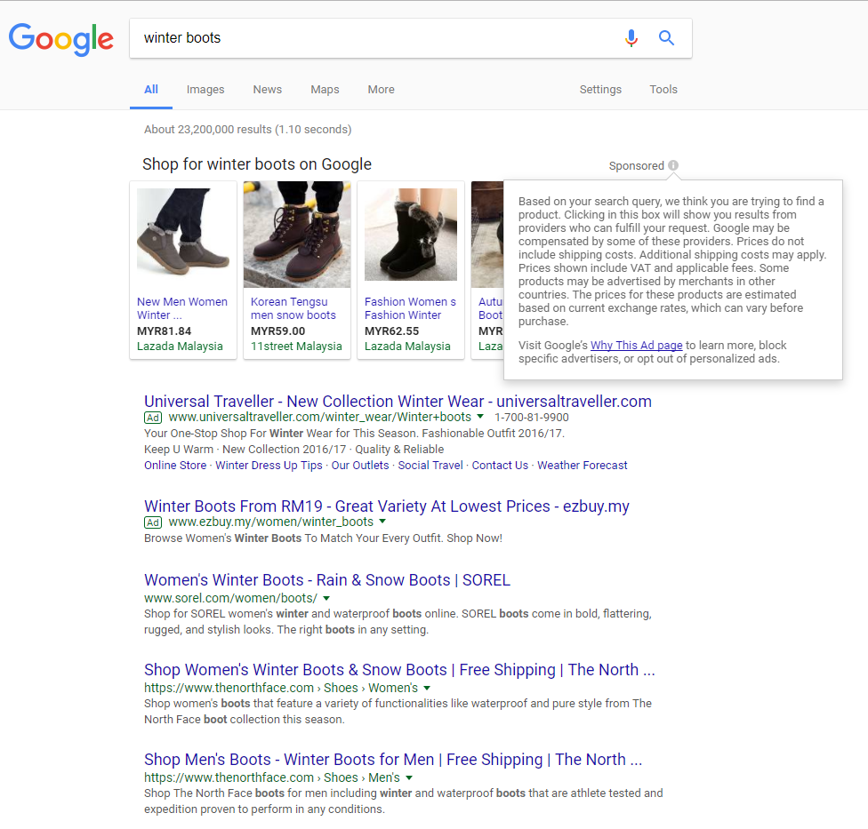
Search Engine Advertising
SEA
Search Engine Advertising
SEA
Search Engine Optimization
SEO

Slide 4
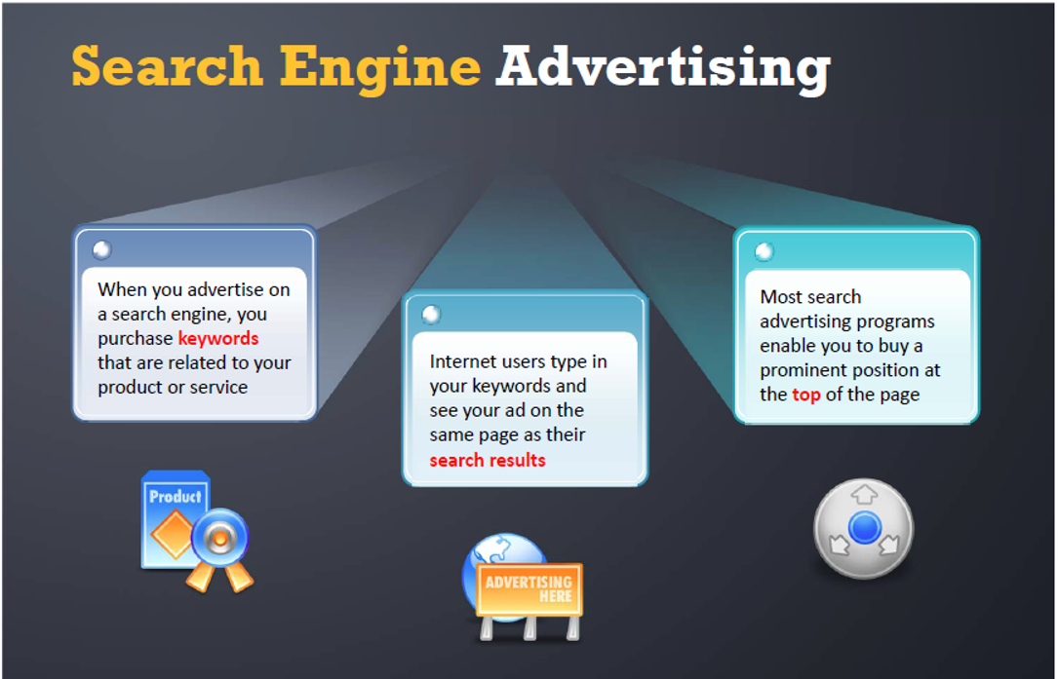

Slide 5
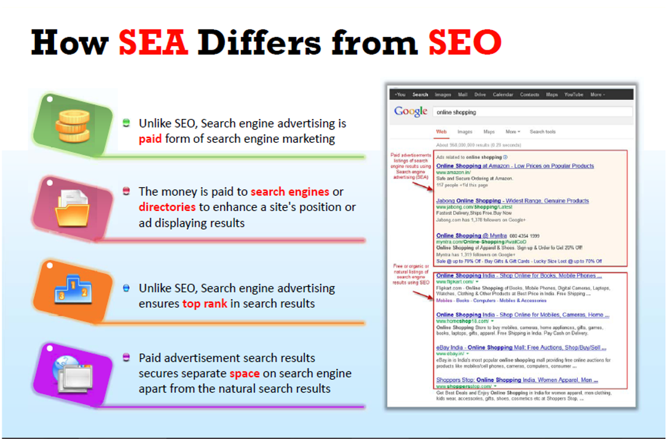

Slide 6
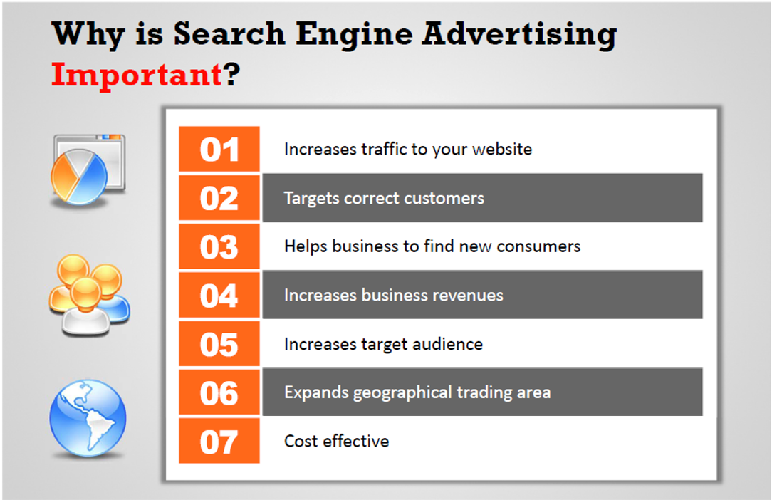

Slide 7
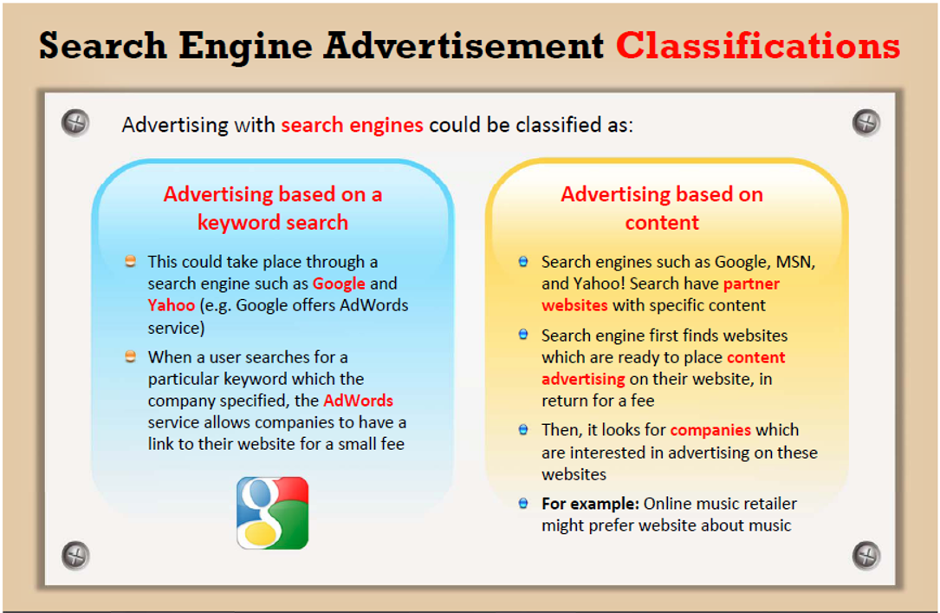

Slide 8
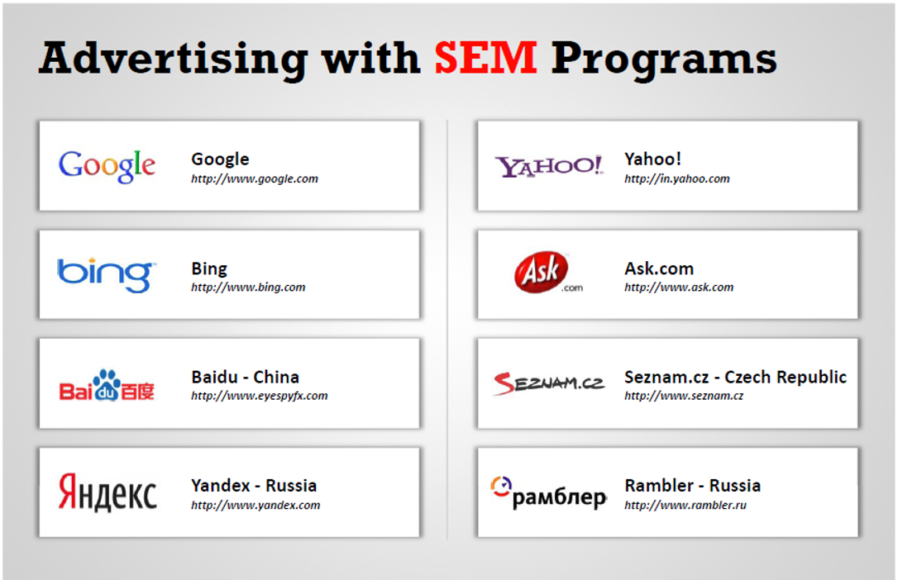

Slide 9
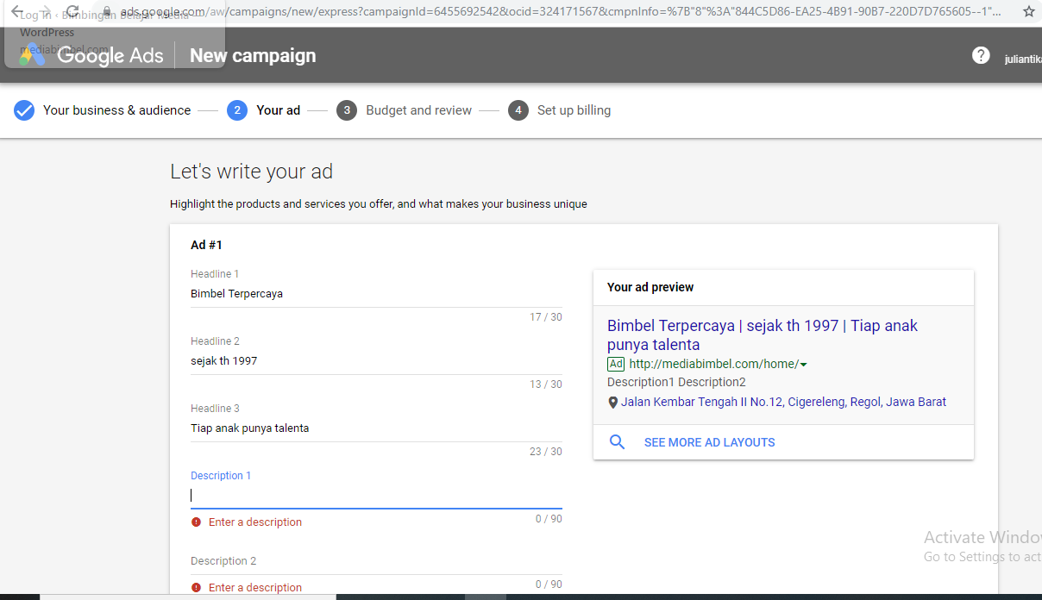
Contoh pembuatan Google ADS

Slide 10
BENEFITS OF USING GOOGLE Ads
Scalability
Tools : spread sheet keuangan dll
Bulk Management
Measurability
Unlimited Optimization
More Conversions
Google my business help

Slide 11
How Google Ads Works

Slide 12
TYPES OF ADS – SEARCH ADS

Slide 13
TYPES OF ADS – DISPLAY ADS

Slide 14
TYPES OF ADS – VIDEO ADS

Slide 15
TYPES OF ADS – UNIVERSAL APP ADS

Slide 16
TYPES OF ADS – SHOPPING ADS

Slide 17
Creating an Optimal Campaign Structure

Slide 18
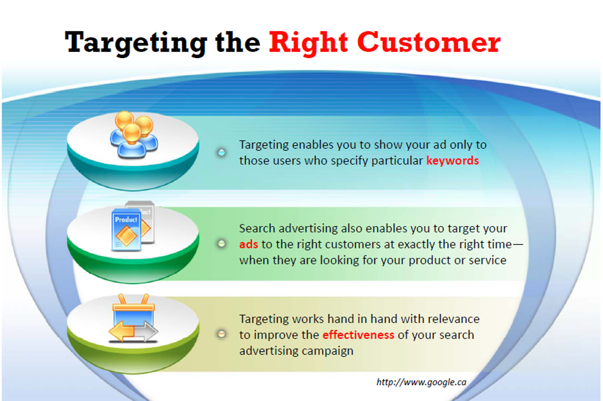

Slide 19
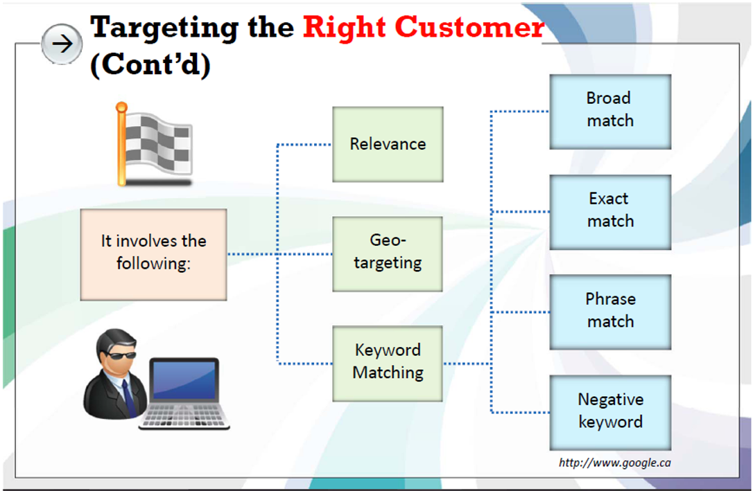

Slide 20
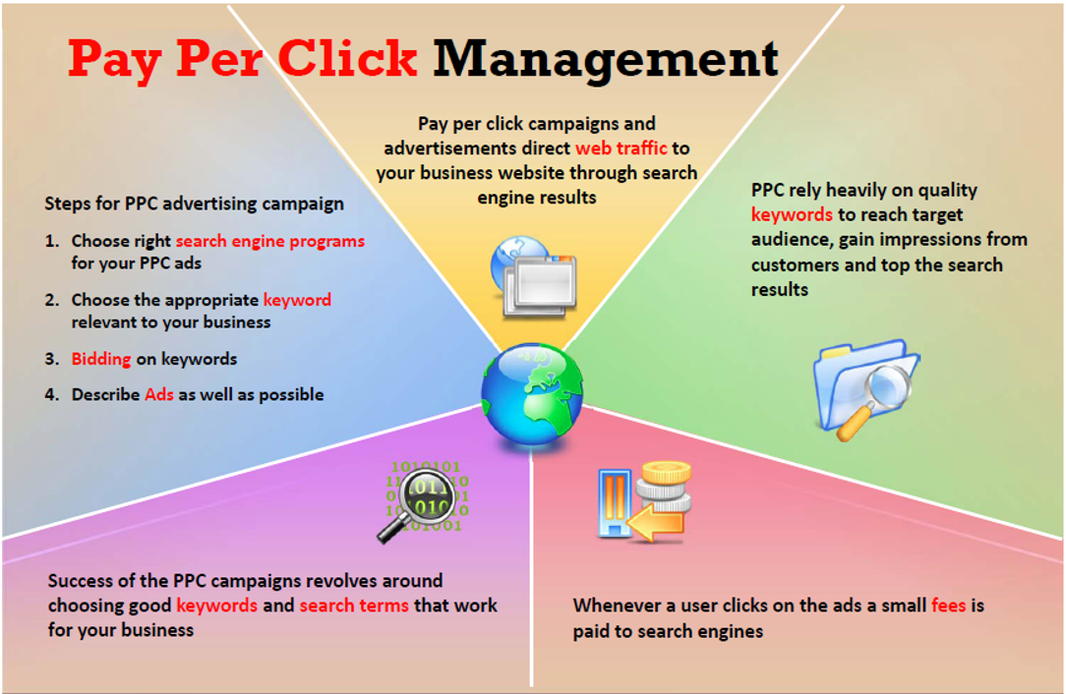

Slide 21
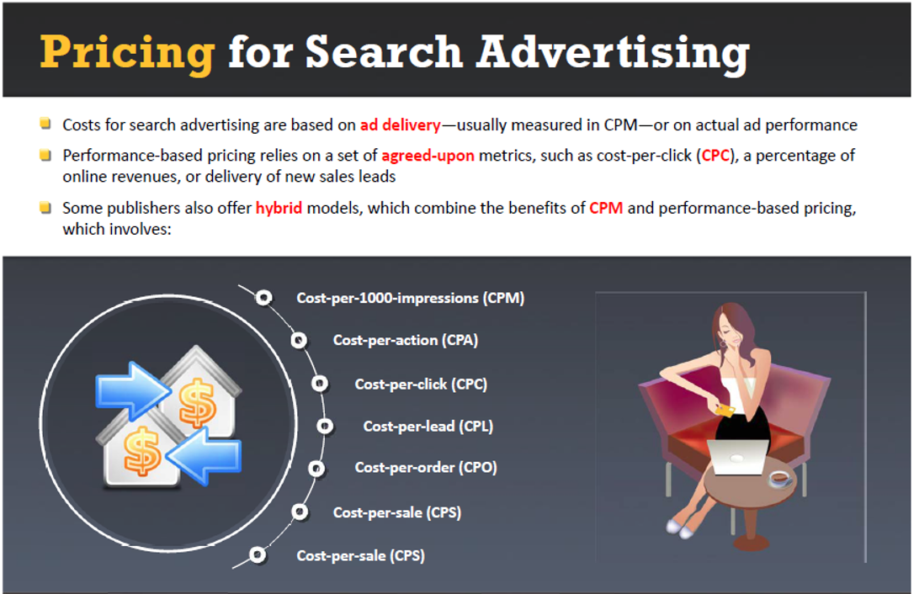

Slide 22
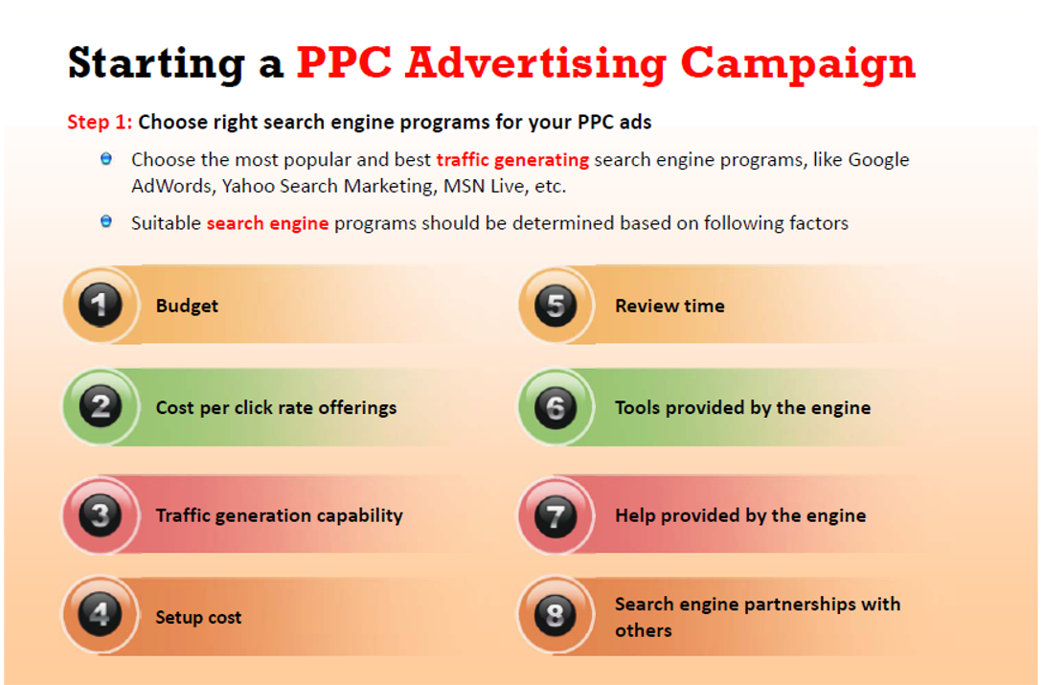

Slide 23
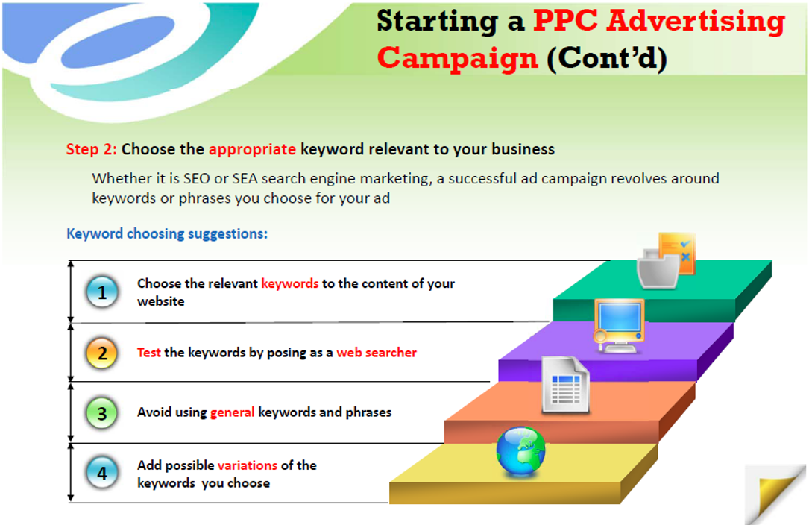

Slide 24
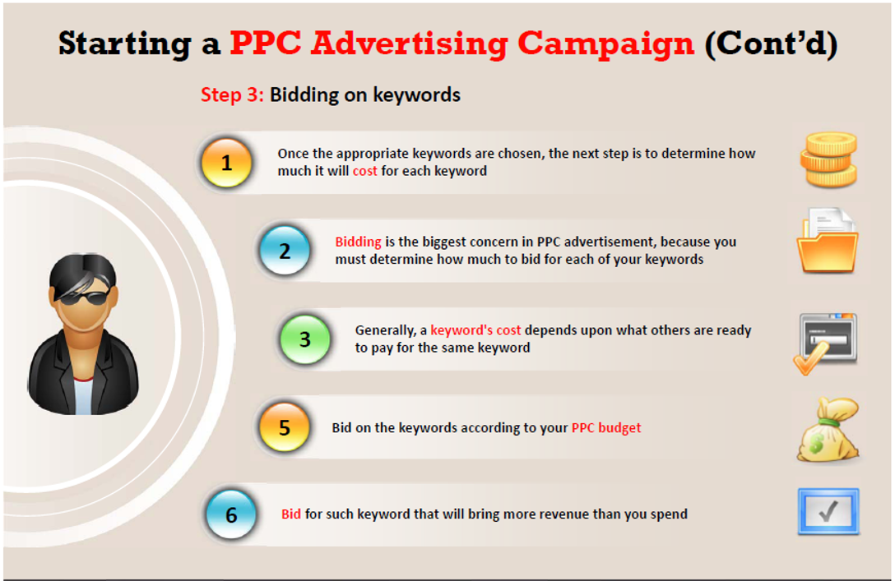

Slide 25
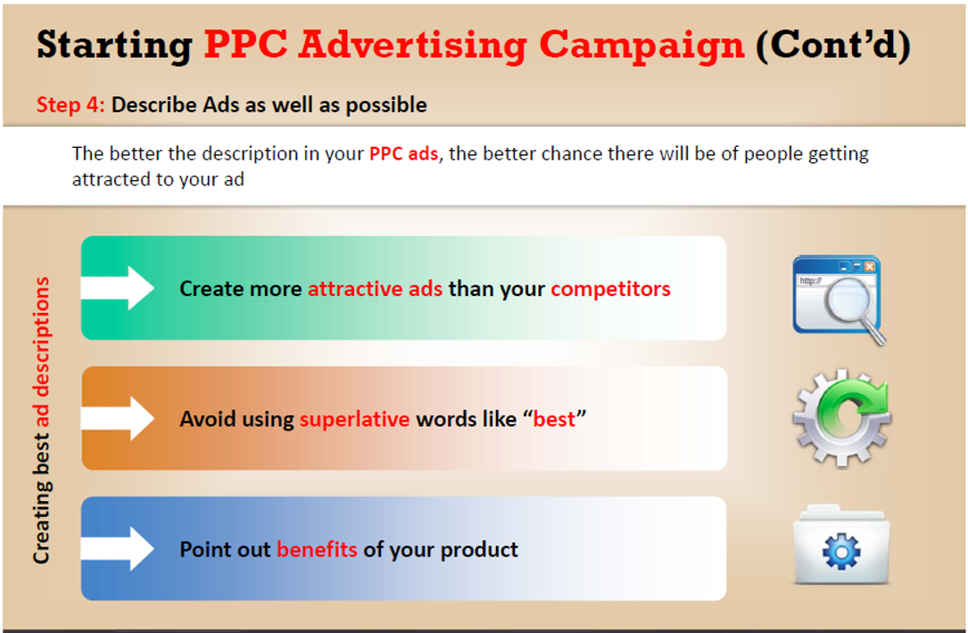

Slide 26
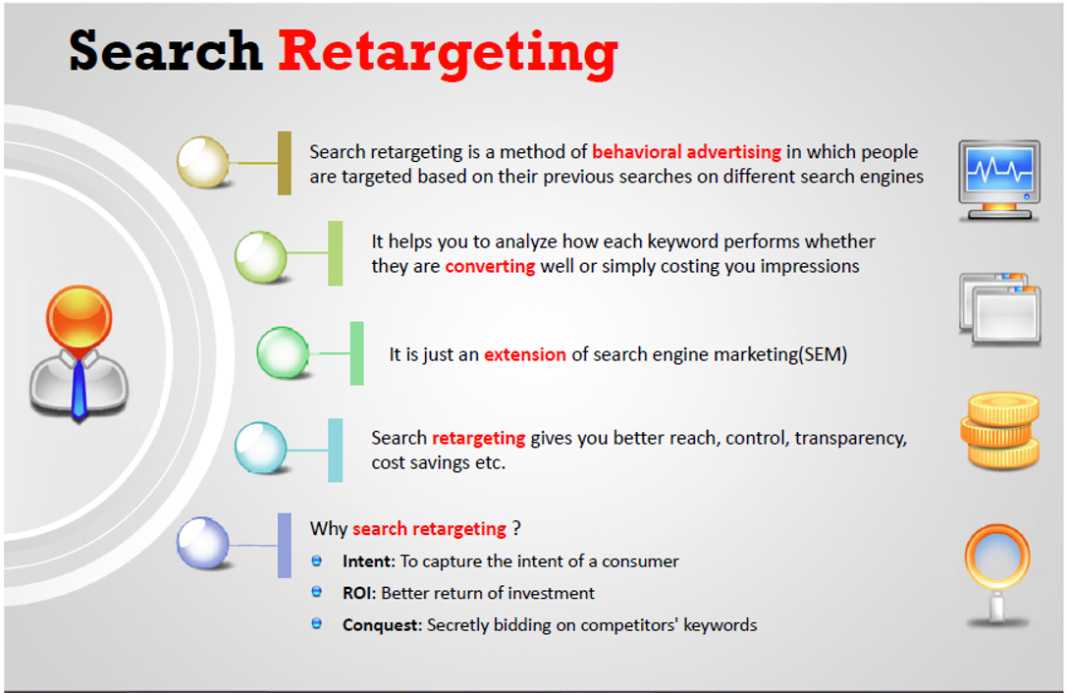

Slide 27
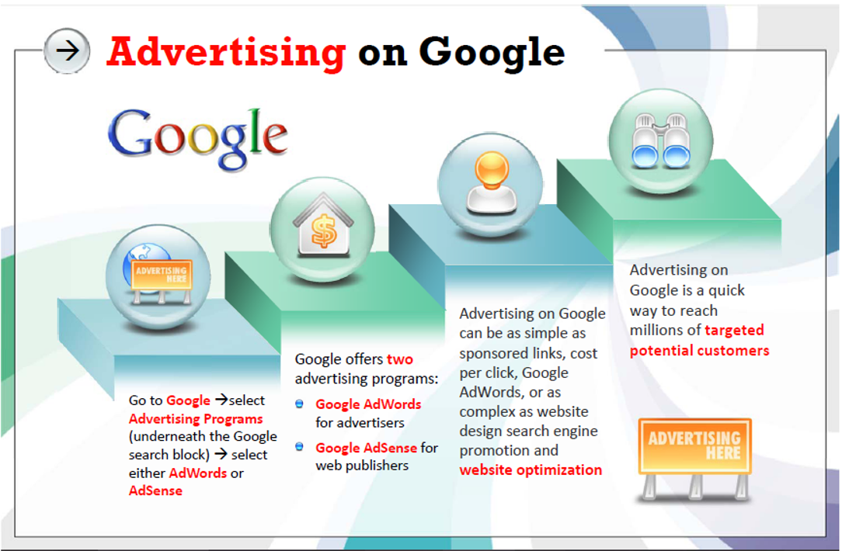

Slide 28
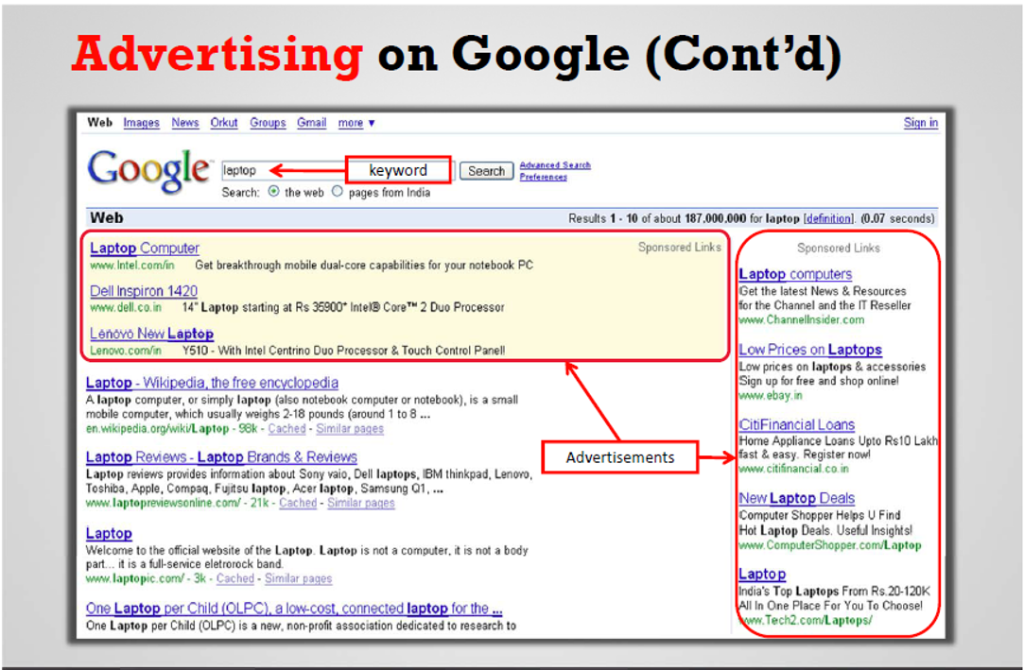

Slide 29
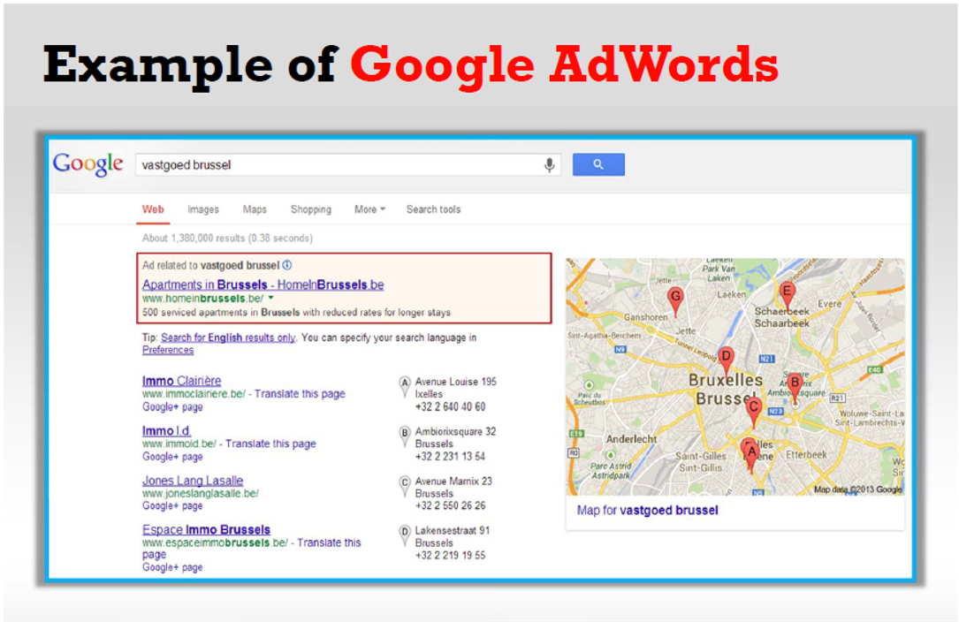

Slide 30
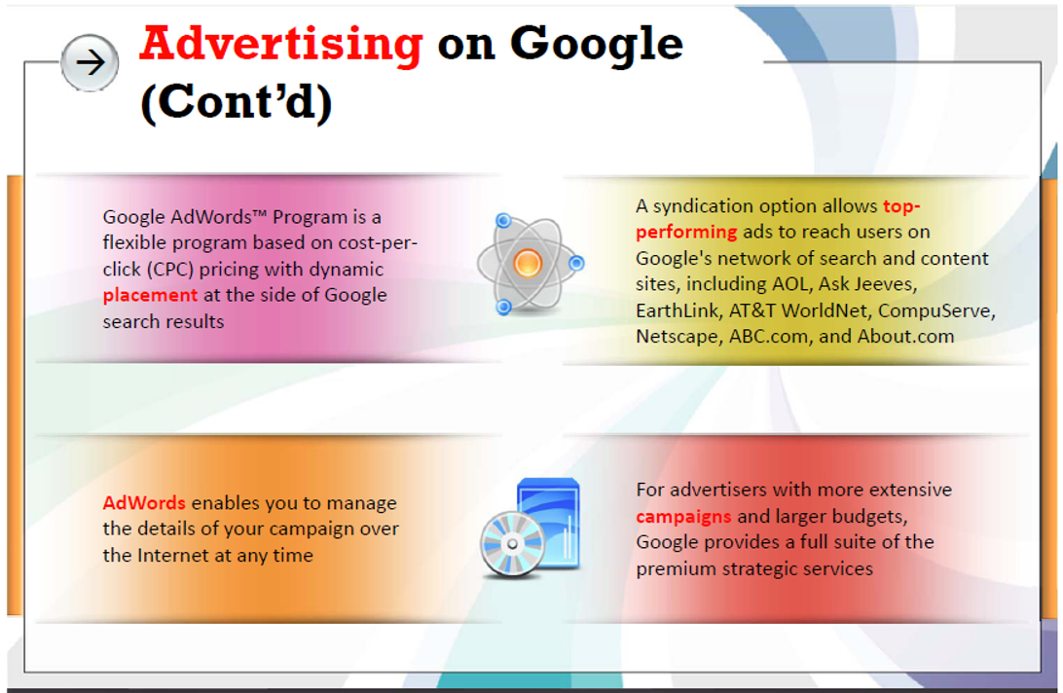

Slide 31
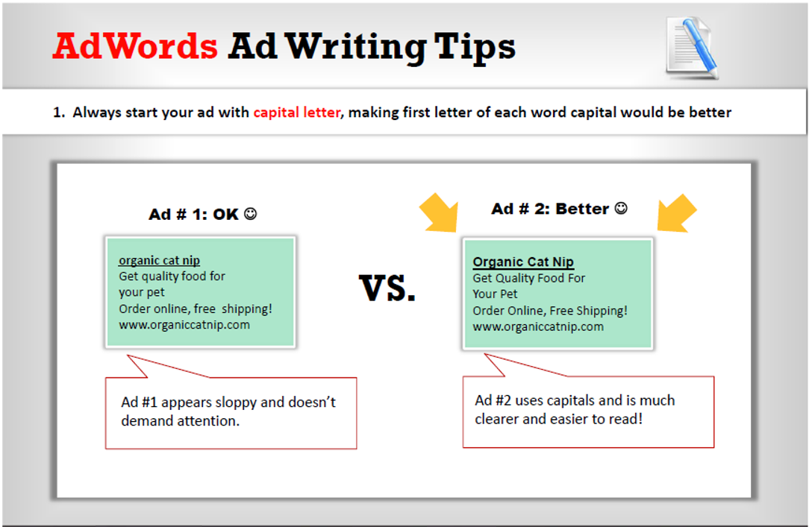

Slide 32
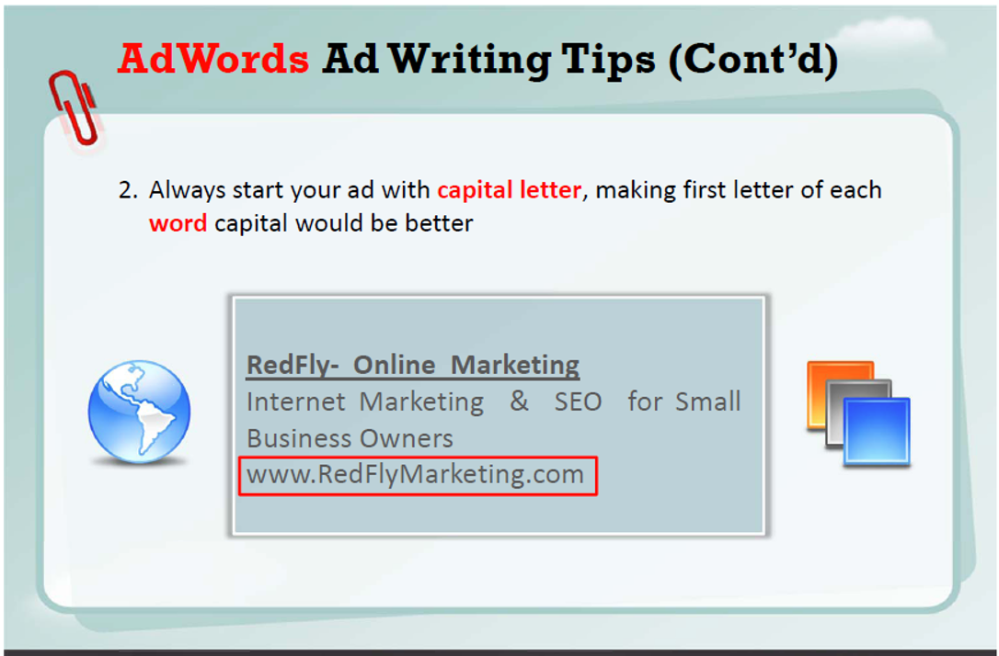

Slide 33
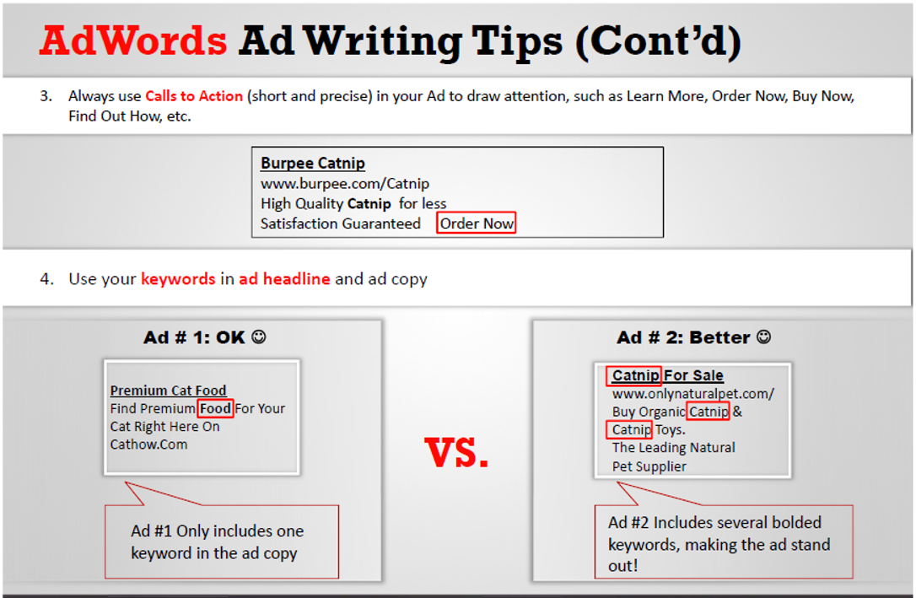

Slide 34
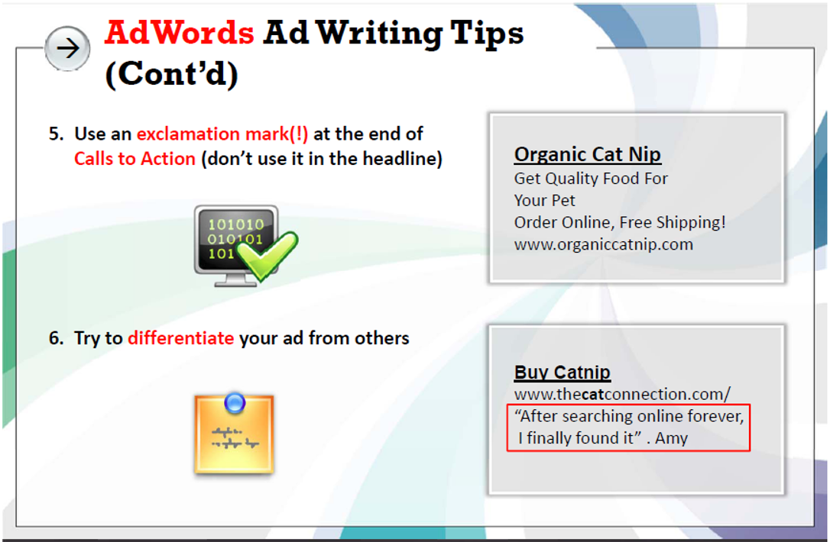

Slide 35
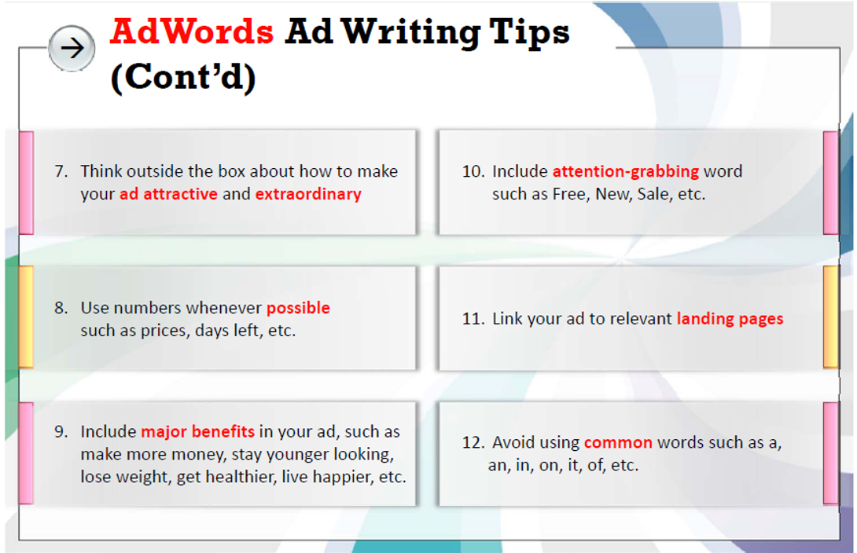

Slide 36
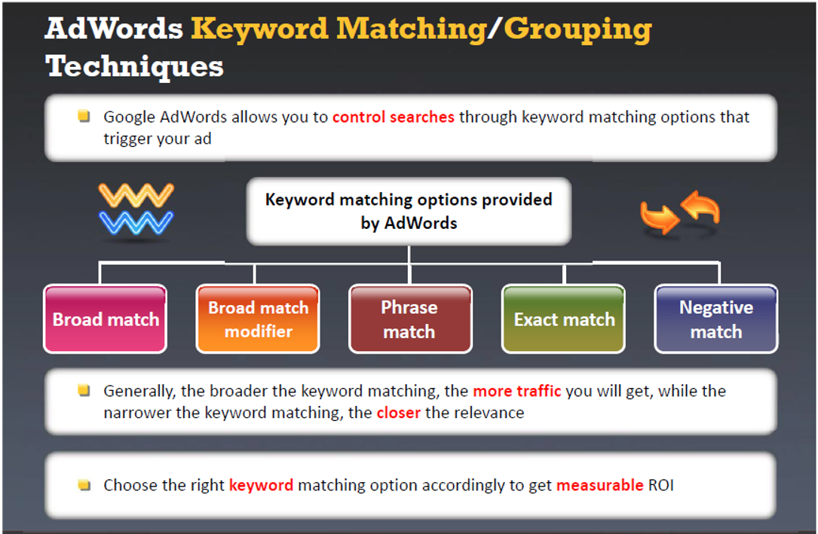

Slide 37
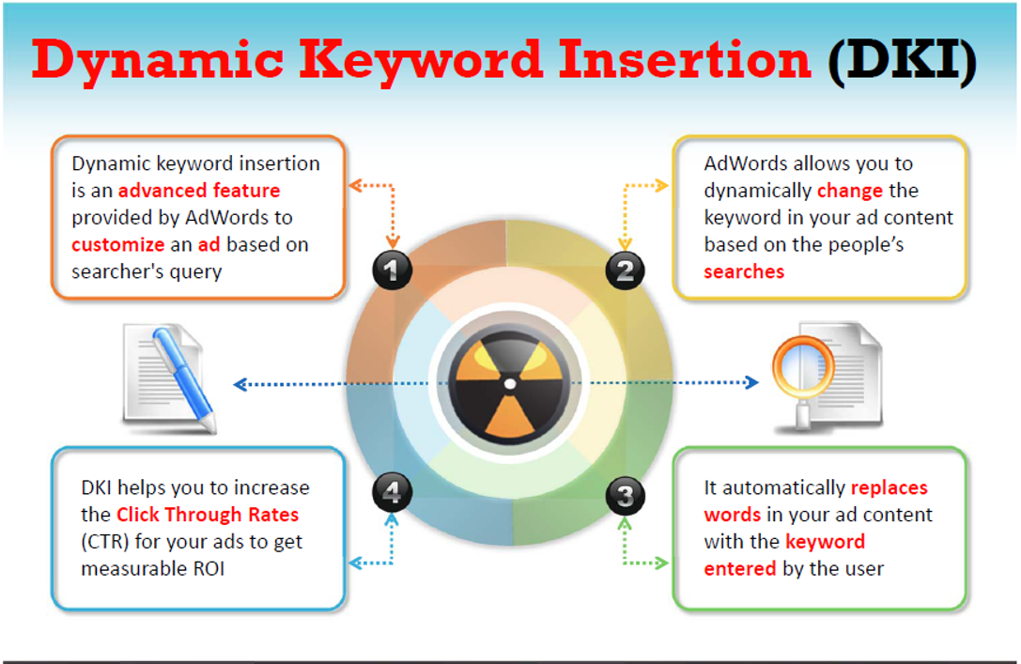

Slide 38
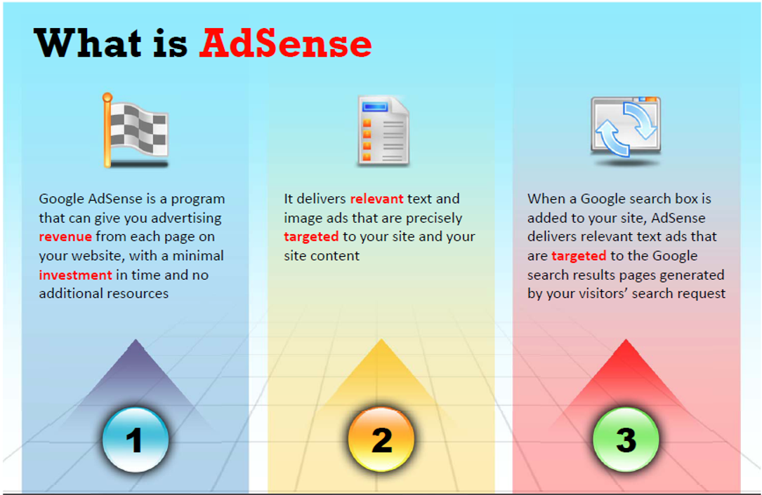

Slide 39
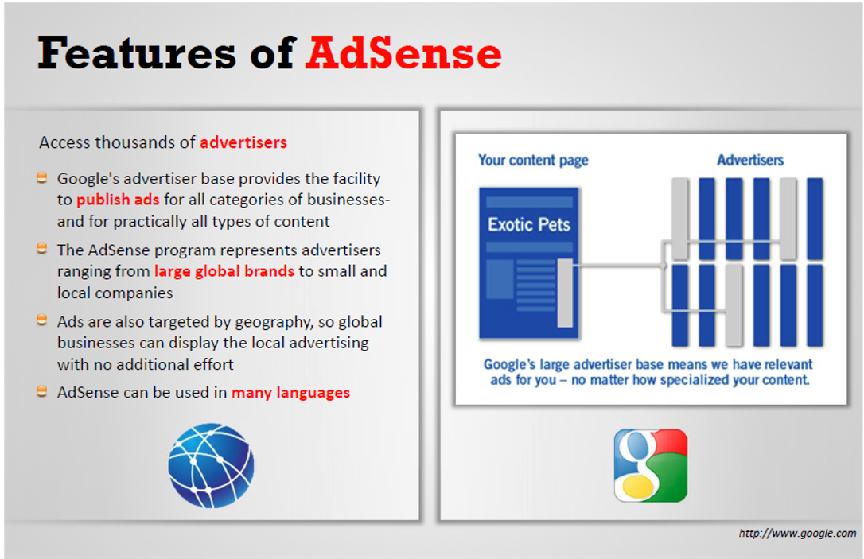

Slide 40
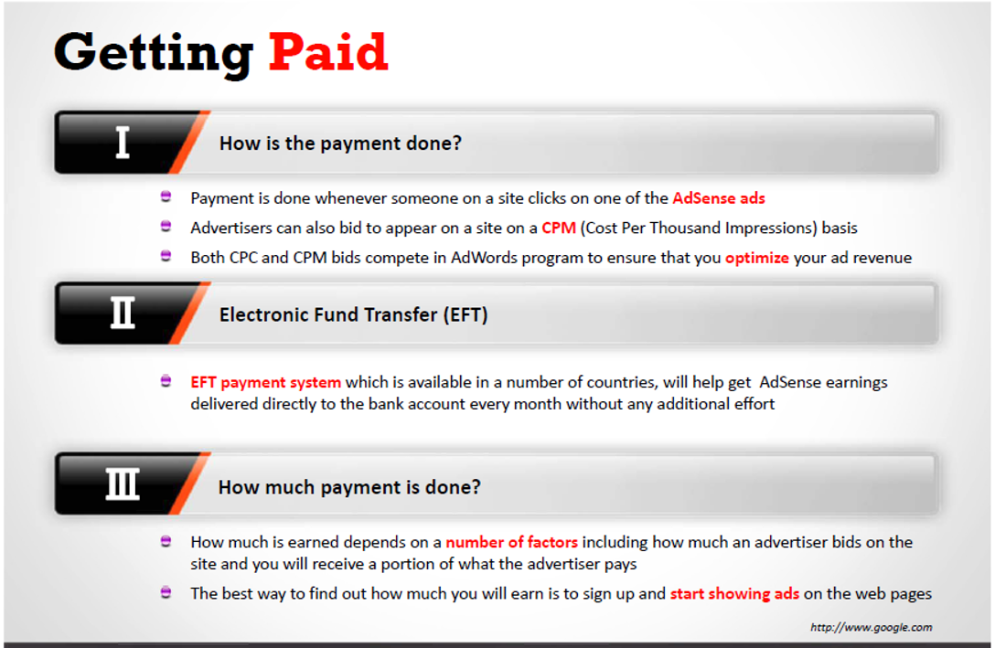

Slide 41
latihan
1. Buat Google AdWords →
berupa link dengan Meta Description
Buat masing masing … lalu persentasikan
2. Follow up kerja kelompok pembuatan website
3. PR pelajari bahan 1 sd 6
Minggu depan ada quiz

